Slide 1
BCS122 Data Structure and Algorithms
Lecture 5 – Part A
Queues – Data Structure
Muhammad khan
Department of IT

Slide 2
Objectives
  Part A:
  Basic concepts of Queue
  Operations on Queues
  Array and pointed based implementation
  Problem with array based implementation
  Part B:
  Application of Queues
  Variation in Queues (priority queue, dequeue)

Slide 3
Contents
Definition of Queue
Rules/ Principles for Operating on Queue
Queue ADTs
Representation of Queues in Computer Memory:
Array Based Queue
  Operations on Queue
  Rightward drift problem:
Pointer based Queue
  Declaration or data structure of queue along with necessary pointers:
More types of Queues:
  Priority Queue

Slide 4
Definition
A linear list of items with the property of deleting item at the front and adding item at the end of queue (FIFO):
Rules/Principle:
  Rule 1: Addition to the queue can be done at the REAR end only
  Rule 2: Deletion from the queue can be done at the FRONT end only

Slide 5
Queue ADT
Add an element to the back of the queue
Remove an element from the front of the queue
Retrieve the value at the front of the queue
Other Operations:
  To check if the queue is empty before an element can be removed
  To check if the queue is full before an element can be added

Slide 6
Representation of Queues in Computer Memory
Queues can be represented in two ways in Computer memory:
  Array based
  Pointer based

Slide 7
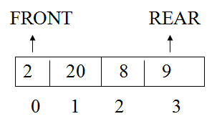
Array Based Representaion
For example we want to store the following integer items in queue:
2, 20, 8 and 9
We need to define an integer array and necessary pointers, i.e., FRONT and REAR
int queue[4];
int FRONT, REAR=0;

Slide 8
Operations on Queue
Inserting items to the queue: (using C++ Language)
  Only one items in queue can be inserted at REAR (according to principle of queue), the following statement in C++ language will be required:
Get data in an item (assuming that item is a variable defined by user of same type as queue) i.e, item = new data;
store item at the ‘rear’ position in the queue, e.g.,
queue[REAR]=item;
Increase rear by – 1, to get a new location for next ‘insert’ operation e.g.,
REAR++;

Slide 9
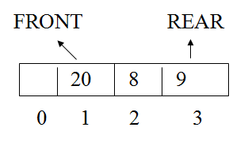
Deleting Items from Queue
Only one items from queue can be deleted at the front (according to principle of queue), the following statement in C++ language will be required:
Items can be deleted by incrementing FRONT by 1.
    i.e., FRONT++
e.g., we delete one item from the above queue, it will look like as:

Slide 10
Other Operations
It is always important to check the status of queue before any operations: such as
  Full - queue
  Empty – queue

Slide 11
Full Queue
To check if the queue is full before an element can be added
  REAR pointer can be used to know whether the queue is empty (have some space) to insert a new item:
If REAR = size of the array
The queue is full
e.g., Size of queue is equal to ‘n’, the following statement in C++ can be used:
If REAR == n
cout << “the queue is full”;

Slide 12
Empty Queue
To check if the queue is empty before an element can be removed
  Both FRONT and REAR pointers can be used to know whether the queue is empty (have any element) to remove an item:

Slide 13
Case No. 1
If REAR = FRONT = –1 or NULL depending on the initialization of these variables.
e.g., REAR and FRONT = -1 (are initialized with –1)
in C++:
If (REAR == -1) && (FRONT ==-1)
cout << “the queue is empty”;

Slide 14
Case No. 2
If REAR is pointing to empty location in the array, the following statement can be used to check whether the queue is empty:
in C++:
If ( FRONT == REAR )
cout << “the queue is empty”;

Slide 15
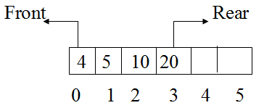
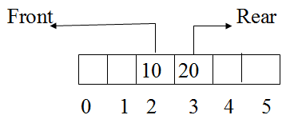
Rightward Drift Problem
Consider the following queue with 6 locations:
After deleting front two items, the queue along with its pointers is shown below.

Slide 16
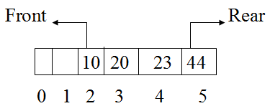
Rightward Drift Problem (contd.)
Suppose we enter two more elements, the queue will look as follows:
It may be noted that more items cannot be added to the queue
  because REAR pointer pointing to last location. But the queue has got two empty locations. This situation is known as “right-drift” problem.

Slide 17
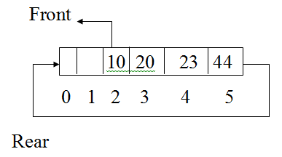
Solution to Right-drift problem
Case 1: Move items upward with each deletion. It may be time-consuming problem.
Case 2: An alternative approach that overcomes this problem is to use a circular queue as shown in the following figure:

Slide 18
Pointer Based Representation
Pointer, i.e., dynamic data structure is used to represent queue in computer memory.
Pointer based queue has got some advantages over the static (array based) representation. For example:
  No need to fix locations at the beginning of application
  No right-drift problem situation.
  Easy to delete and add new items.
and many others.

Slide 19
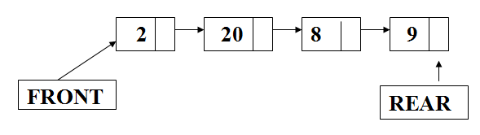
Example
For example we want to store the following integer items in queue:
2, 20, 8 and 9
Diagrammatically representation of the above data in a pointer based queue:

Slide 20
Declaration or Data Structure of Queue along with necessary pointers
Struct queue_node
{
int item;
queue_node* next;
}
typedef queue_node* Qptr;

Slide 21
Deletion and Addition of Items in Queue
Deletion at Front:
  Same rules to deleted items from queue will be used – as discussed with the array based, i.e., to delete at the front of the queue
  ‘FRONT’ pointer will be used in the following ways:
  The following statement in C++ can be used to delete item from Queue:
  FRONT = FRONT->NEXT;
  Above statement will push FRONT pointer by one step in the queue, subsequently first item in the queue will not be accessible anymore

Slide 22
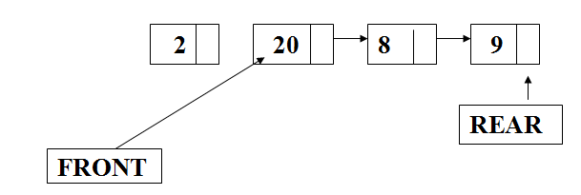
Deletion and Addition of Items in Queue (contd.)

Slide 23

Deletion and Addition of Items in Queue (contd.)
Same rules to add items into the queue will be used – as discussed with the array based, i.e., to add at the rear of the queue
‘REAR pointer will be used in the following ways:
The following statements can be used to add new item to pointer-based queue:
  Create a temp pointer: temp = new node;
  Put the required data temp->item = 2;

Slide 24
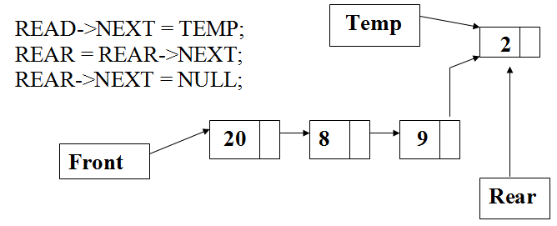
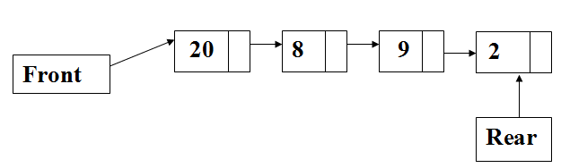
Deletion and Addition of Items in Queue (contd.)
Connect this new node with the list by using the following statements:
delete TEMP at end:
delete temp; and result is shown diagrammatically below:

Slide 25
Applications
Simulation the Operation of a Shop: (Application of Queues)
The Queue ADT can be used to simulate the operations of a shop and decide on the optimal number of cashiers required based on the following variables:
  Customer entry interval, E
  Customer shopping time, S
  Service time at the cashier’s desk, P

Slide 26
Steps
T=0 // T represent the program clock/time
loop T++
if(T%E==0)
  a new customer joins the shopqueue,
  so the value of T is added to the queue
if(T==front of shopqueue + S)
  remove from shopqueue
  so the value of (frontofshopqueue +S) to the cashierqueue
if(T==front of cashierqueue+P)
  remove from cashier queue
Display the shopping queue
Display the cashier queue
Until (T==R) … loop terminate which started from step 2.

Slide 27
Steps (contd.)
At the end the following two reports can be printed:
  Print the number of customers that shopped
  Print the highest length of the cashier queue

Slide 28
